Slide 1
Lecture 12:
Software Packages
Caffe / Torch / Theano / TensorFlow

Slide 2
Administrative
Milestones were due 2/17; looking at them this week
Assignment 3 due Wednesday 2/22
If you are using Terminal: BACK UP YOUR CODE!

Slide 3
Caffe http://caffe.berkeleyvision.org

Slide 4
Caffe Overview
From U.C. Berkeley
Written in C++
Has Python and MATLAB bindings
Good for training or finetuning feedforward models

Slide 5
Most important tip...
Don’t be afraid to read the code!

Slide 6
SoftmaxLossLayer
Caffe: Main classes
fc1
data
Blob: Stores data and derivatives (header source)
Layer: Transforms bottom blobs to top blobs (header + source)
Net: Many layers; computes gradients via forward / backward (header source)
Solver: Uses gradients to update weights (header source)
diffs
InnerProductLayer
W
data
X
data
y
data
diffs
diffs
diffs
DataLayer

Slide 7
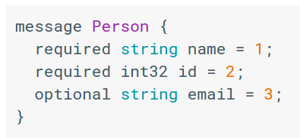
Caffe: Protocol Buffers
“Typed JSON” from Google
Define “message types” in .proto files
.proto file
https://developers.google.com/protocol-buffers/

Slide 8
Caffe: Protocol Buffers
“Typed JSON” from Google
Define “message types” in .proto files
Serialize instances to text files (.prototxt)
.proto file
.prototxt file
name: “John Doe”
id: 1234
email: “jdoe@example.com”
https://developers.google.com/protocol-buffers/

Slide 9
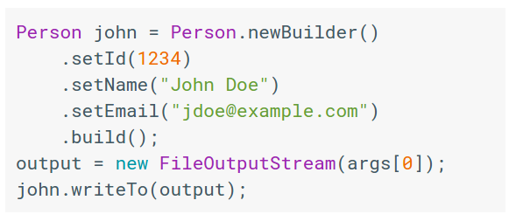
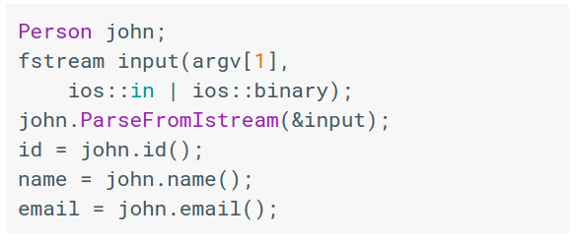
Caffe: Protocol Buffers
“Typed JSON” from Google
Define “message types” in .proto files
Serialize instances to text files (.prototxt)
Compile classes for different languages
.proto file
Java class
C++ class
.prototxt file
name: “John Doe”
id: 1234
email: “jdoe@example.com”
https://developers.google.com/protocol-buffers/

Slide 10
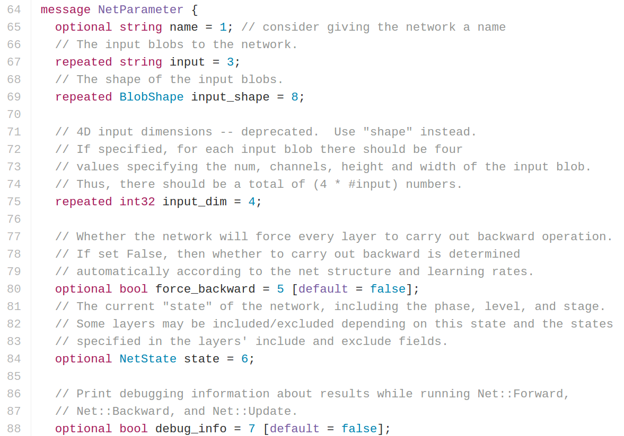
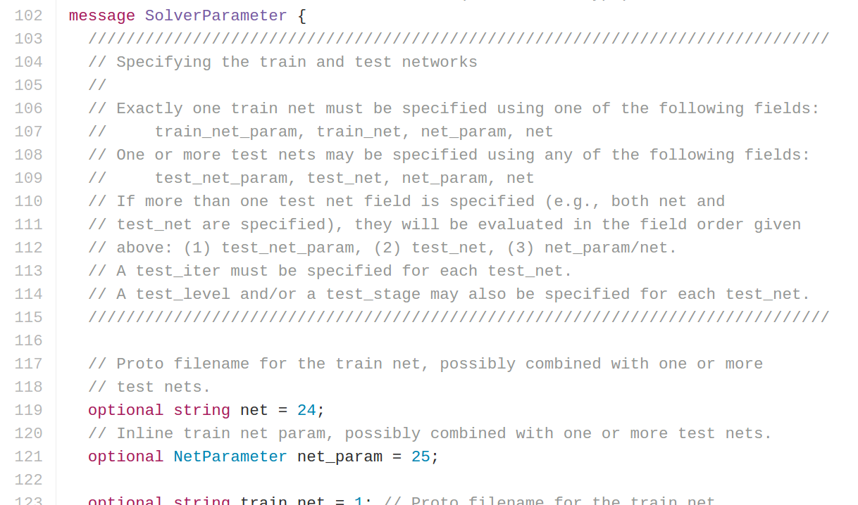
Caffe: Protocol Buffers
https://github.com/BVLC/caffe/blob/master/src/caffe/proto/caffe.proto
<- All Caffe proto types defined here, good documentation!

Slide 11
Caffe: Training / Finetuning
No need to write code!
Convert data (run a script)
Define net (edit prototxt)
Define solver (edit prototxt)
Train (with pretrained weights) (run a script)

Slide 12
Caffe Step 1: Convert Data
DataLayer reading from LMDB is the easiest
Create LMDB using convert_imageset
Need text file where each line is
“[path/to/image.jpeg] [label]”
Create HDF5 file yourself using h5py

Slide 13
Caffe Step 1: Convert Data
ImageDataLayer: Read from image files
WindowDataLayer: For detection
HDF5Layer: Read from HDF5 file
From memory, using Python interface
All of these are harder to use (except Python)
LMDB format is always an easy option

Slide 14
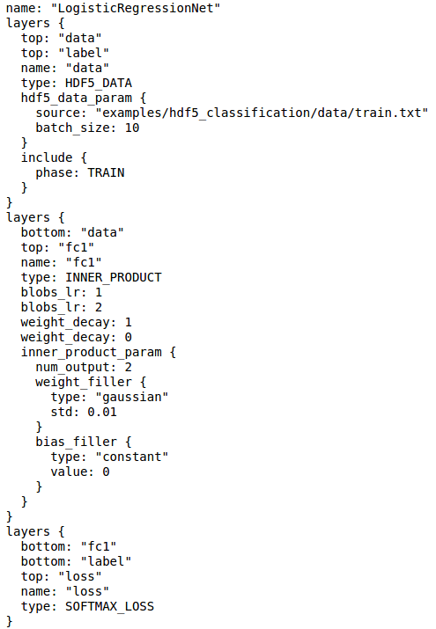
Caffe Step 2: Define Net

Slide 15
Caffe Step 2: Define Net
Layers and Blobs often have same name!

Slide 16
Caffe Step 2: Define Net
Layers and Blobs often have same name!
Learning rates (for both weights as well as bias)
Regularization (for both weights as well as bias)

Slide 17
Caffe Step 2: Define Net
Number of output classes
Layers and Blobs often have same name!
Learning rates (weight + bias)
Regularization (weight + bias)

Slide 18
Caffe Step 2: Define Net
Number of output classes
Layers and Blobs often have same name!
Set these to 0 to freeze a layer
Learning rates (weight + bias)
Regularization (weight + bias)

Slide 19
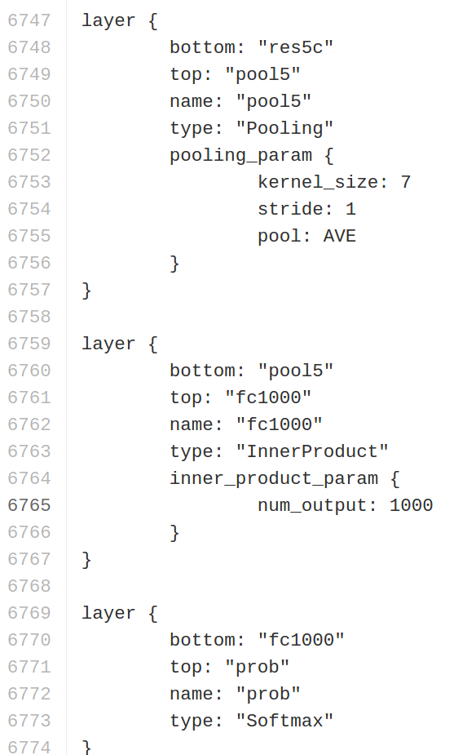
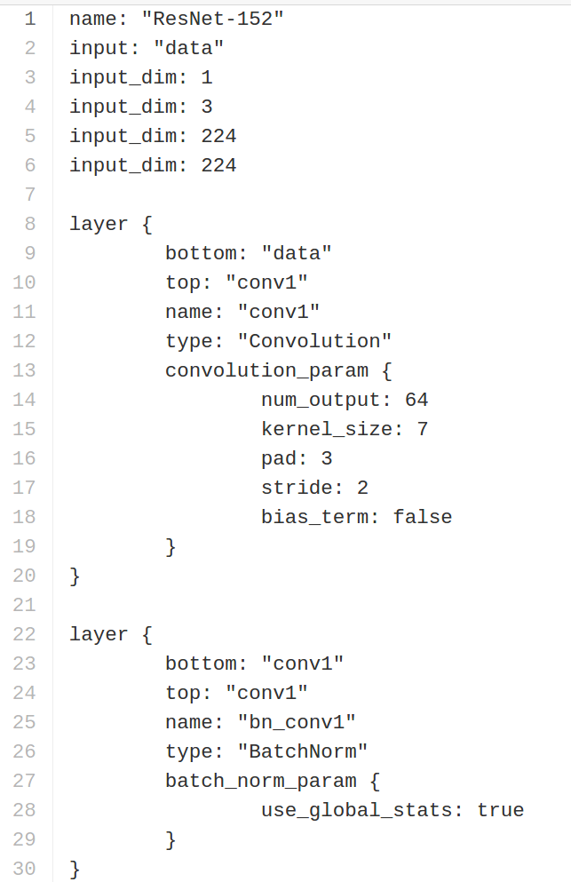
Caffe Step 2: Define Net
.prototxt can get ugly for big models
ResNet-152 prototxt is 6775 lines long!
Not “compositional”; can’t easily define a residual block and reuse
https://github.com/KaimingHe/deep-residual-networks/blob/master/prototxt/ResNet-152-deploy.prototxt

Slide 20
Caffe Step 2: Define Net (finetuning)
Original prototxt:
layer {
name: "fc7"
type: "InnerProduct"
inner_product_param {
num_output: 4096
}
}
[... ReLU, Dropout]
layer {
name: "fc8"
type: "InnerProduct"
inner_product_param {
num_output: 1000
}
}
Modified prototxt:
layer {
name: "fc7"
type: "InnerProduct"
inner_product_param {
num_output: 4096
}
}
[... ReLU, Dropout]
layer {
name: "my-fc8"
type: "InnerProduct"
inner_product_param {
num_output: 10
}
}
Pretrained weights:
“fc7.weight”: [values]
“fc7.bias”: [values]
“fc8.weight”: [values]
“fc8.bias”: [values]

Slide 21
Caffe Step 2: Define Net (finetuning)
Original prototxt:
layer {
name: "fc7"
type: "InnerProduct"
inner_product_param {
num_output: 4096
}
}
[... ReLU, Dropout]
layer {
name: "fc8"
type: "InnerProduct"
inner_product_param {
num_output: 1000
}
}
Same name: weights copied (if the layer name in modified prototype.txt matches with a layer name in model file, caffe initializes the weights with these values
Modified prototxt:
layer {
name: "fc7"
type: "InnerProduct"
inner_product_param {
num_output: 4096
}
}
[... ReLU, Dropout]
layer {
name: "my-fc8"
type: "InnerProduct"
inner_product_param {
num_output: 10
}
}
Pretrained weights:
“fc7.weight”: [values]
“fc7.bias”: [values]
“fc8.weight”: [values]
“fc8.bias”: [values]

Slide 22
Caffe Step 2: Define Net (finetuning)
Hence, if you want to re-initialize a layer(maybe from 1000D output layer to 10D layer, give the layer a different name otherwise error will be generated)
Original prototxt:
layer {
name: "fc7"
type: "InnerProduct"
inner_product_param {
num_output: 4096
}
}
[... ReLU, Dropout]
layer {
name: "fc8"
type: "InnerProduct"
inner_product_param {
num_output: 1000
}
}
Same name: weights copied
Modified prototxt:
layer {
name: "fc7"
type: "InnerProduct"
inner_product_param {
num_output: 4096
}
}
[... ReLU, Dropout]
layer {
name: "my-fc8"
type: "InnerProduct"
inner_product_param {
num_output: 10
}
}
Pretrained weights:
“fc7.weight”: [values]
“fc7.bias”: [values]
“fc8.weight”: [values]
“fc8.bias”: [values]
Different name: weights reinitialized

Slide 23
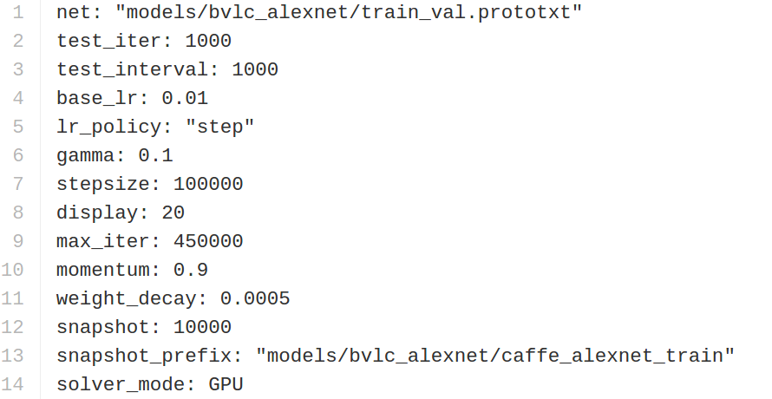
Caffe Step 3: Define Solver
Write a prototxt file defining a SolverParameter
If finetuning, copy existing solver.prototxt file
Change net to be your net
Change snapshot_prefix to your output
Reduce base learning rate (divide by 100)
Maybe change max_iter and snapshot
Very simple file with just 14-15 lines. This can become a complicated file if you are using different learning rates for different parts of your network(i.e. you are Fine tuning the network)

Slide 24
Caffe Step 4: Train!
./build/tools/caffe train \
-gpu 0 \
-model path/to/trainval.prototxt \
-solver path/to/solver.prototxt \
-weights path/to/pretrained_weights.caffemodel
Only this binary file required(Given that you are using LSDM format for the data storage) that is already there in caffe
https://github.com/BVLC/caffe/blob/master/tools/caffe.cpp

Slide 25
Caffe Step 4: Train!
./build/tools/caffe train \
-gpu 0 \
-model path/to/trainval.prototxt \
-solver path/to/solver.prototxt \
-weights path/to/pretrained_weights.caffemodel
-gpu -1 for CPU mode
https://github.com/BVLC/caffe/blob/master/tools/caffe.cpp

Slide 26
Caffe Step 4: Train!
./build/tools/caffe train \
-gpu 0 \
-model path/to/trainval.prototxt \
-solver path/to/solver.prototxt \
-weights path/to/pretrained_weights.caffemodel
-gpu all for multi-GPU data parallelism
https://github.com/BVLC/caffe/blob/master/tools/caffe.cpp

Slide 27
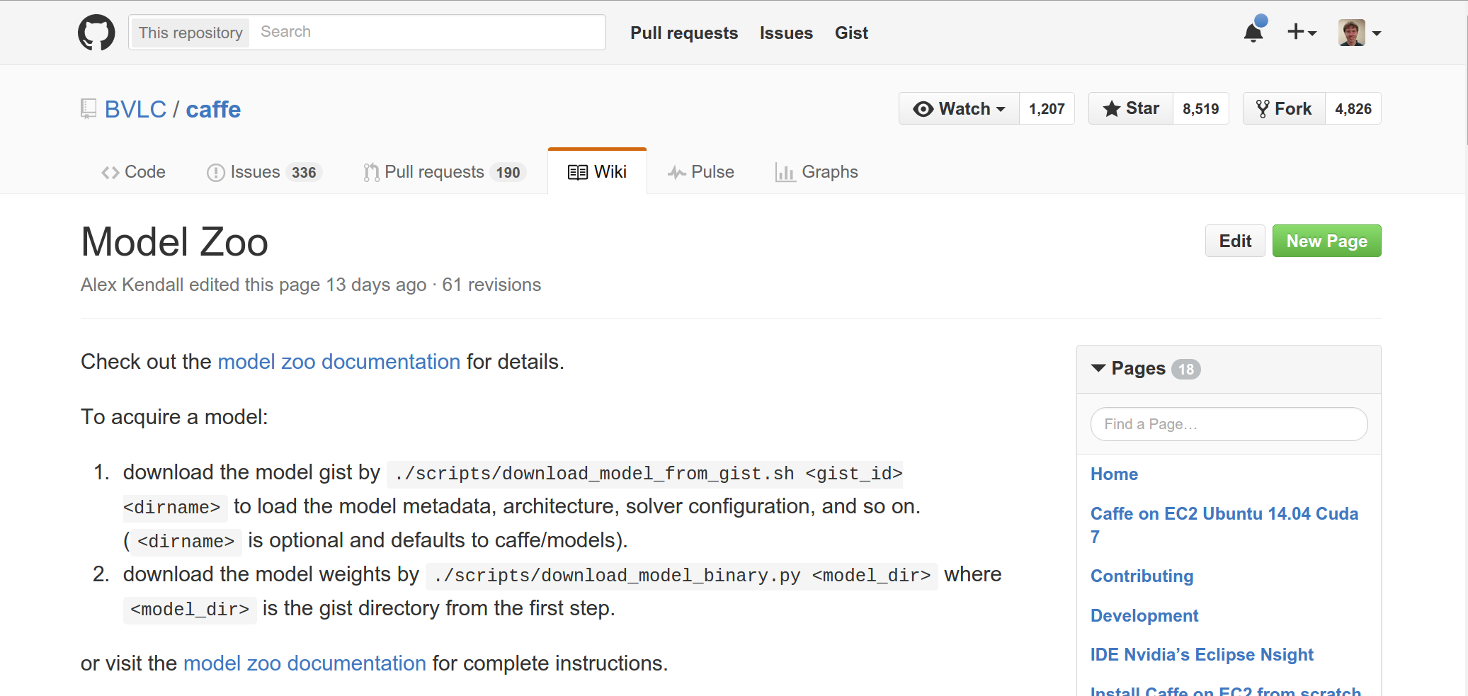
Caffe: Model Zoo
AlexNet, VGG, GoogLeNet, ResNet, plus others
So many popular model are already present in caffe.. Very easy to download and use
https://github.com/BVLC/caffe/wiki/Model-Zoo

Slide 28
Caffe: Python Interface
Not much documentation…
Read the code! Two most important files:
caffe/python/caffe/_caffe.cpp:
Exports Blob, Layer, Net, and Solver classes
caffe/python/caffe/pycaffe.py
Adds extra methods to Net class

Slide 29
Caffe: Python Interface
Good for:
Interfacing with numpy
Extract features: Run net forward
Compute gradients: Run net backward (DeepDream, etc)
Define layers in Python with numpy (the downside is that it works only on the CPU)

Slide 30
Caffe Pros / Cons
(+) Good for feedforward networks(small implementations of feedforward networks)
(+) Good for finetuning existing networks
(+) Train models without writing any code!
(+) Python interface is pretty useful!
(-) Need to write C++ / CUDA for new GPU layers
(-) Not good for recurrent networks (i.e. in networks where different part of the network share the weights)
(-) Cumbersome for big networks (GoogLeNet, ResNet)

Slide 31
Torch http://torch.ch

Slide 32
Torch Overview
From NYU + IDIAP
Written in C and Lua
Used a lot a Facebook, DeepMind

Slide 33
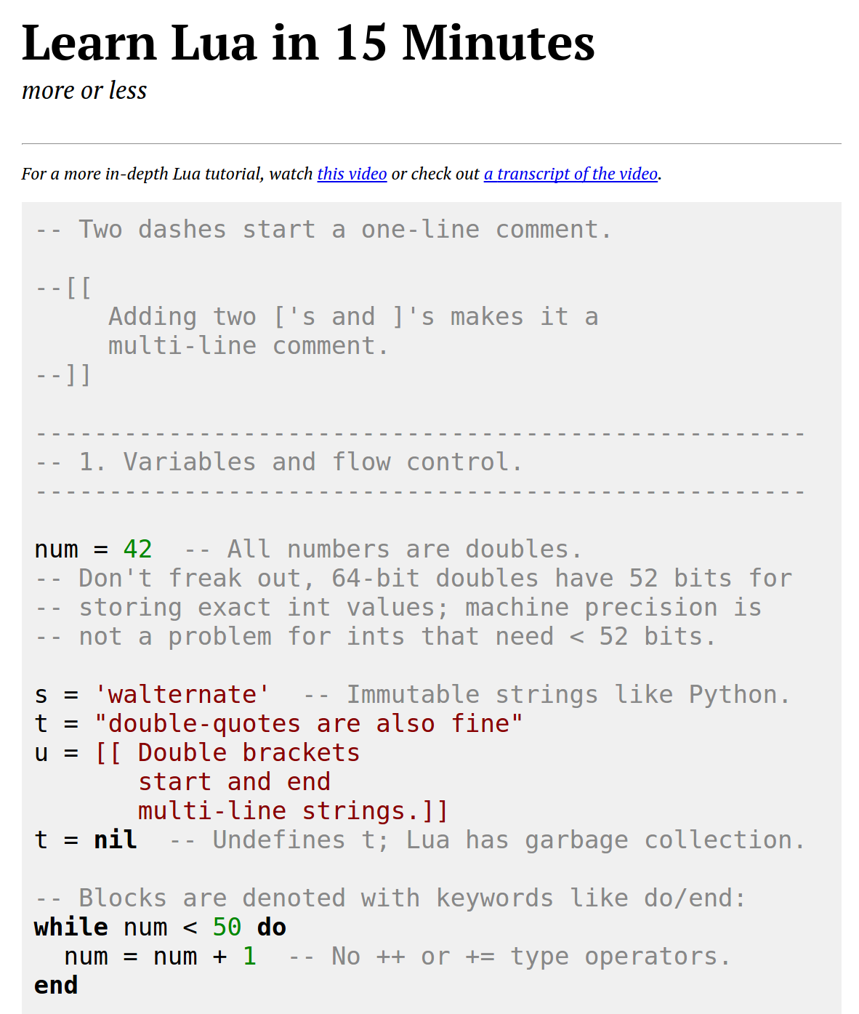
Torch: Lua
High level scripting language, easy to interface with C
Similar to Javascript:
One data structure: table == JS object
Prototypical inheritance metatable == JS prototype
First-class functions
Some gotchas:
1-indexed =(
Variables global by default =(
Small standard library
http://tylerneylon.com/a/learn-lua/

Slide 34
Torch: Tensors
Torch tensors are just like numpy arrays

Slide 35
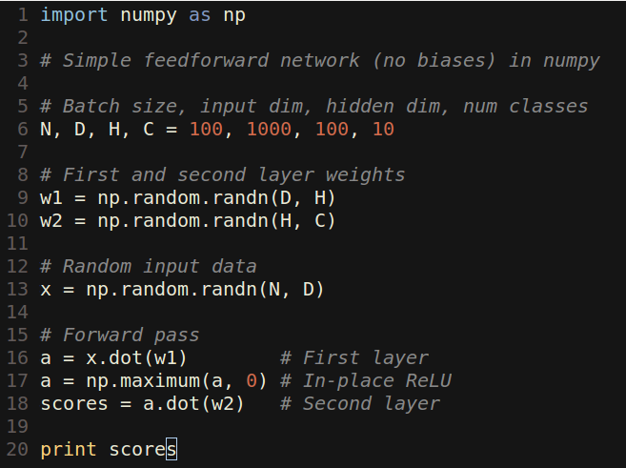
Torch: Tensors
Torch tensors are just like numpy arrays

Slide 36
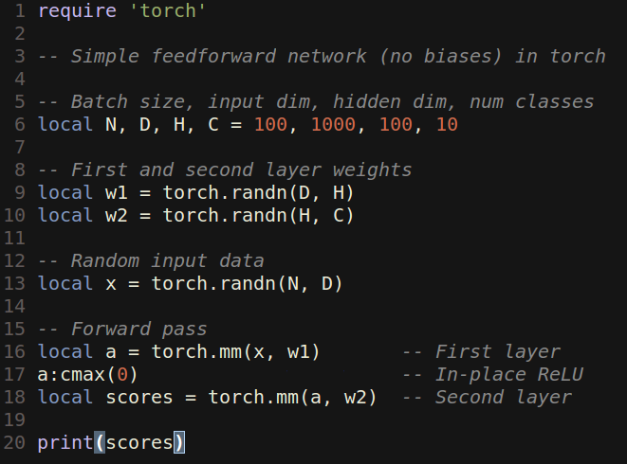
Torch: Tensors
Torch tensors are just like numpy arrays

Slide 37
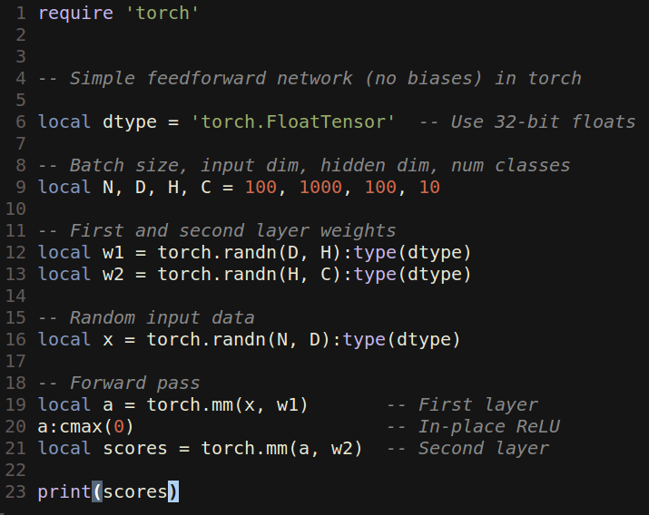
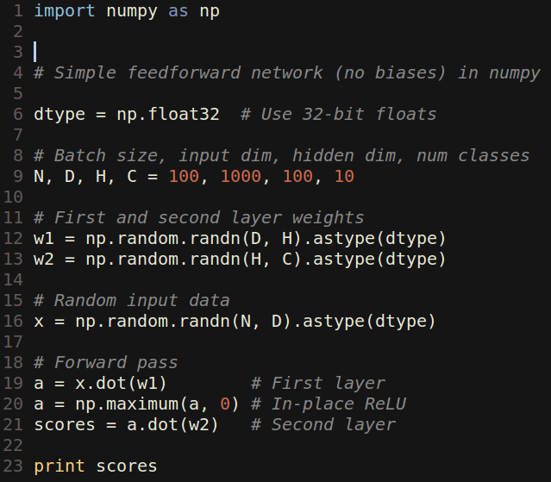
Torch: Tensors
Like numpy, can easily change data type:

Slide 38
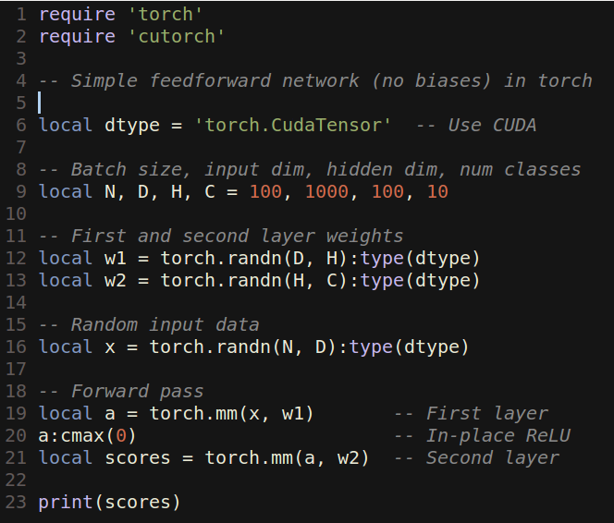
Torch: Tensors
Unlike numpy, GPU is just a datatype away:

Slide 39
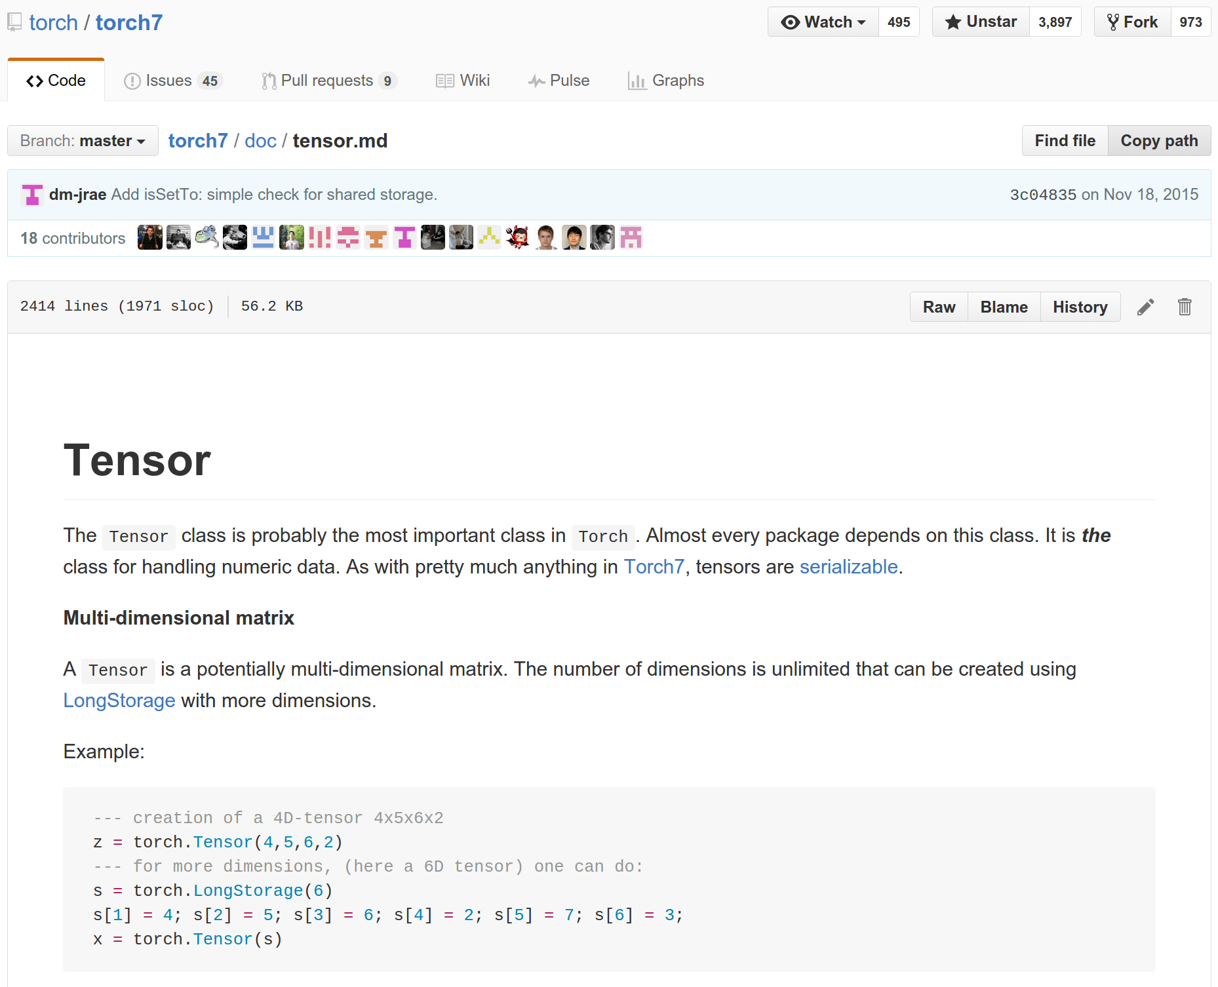
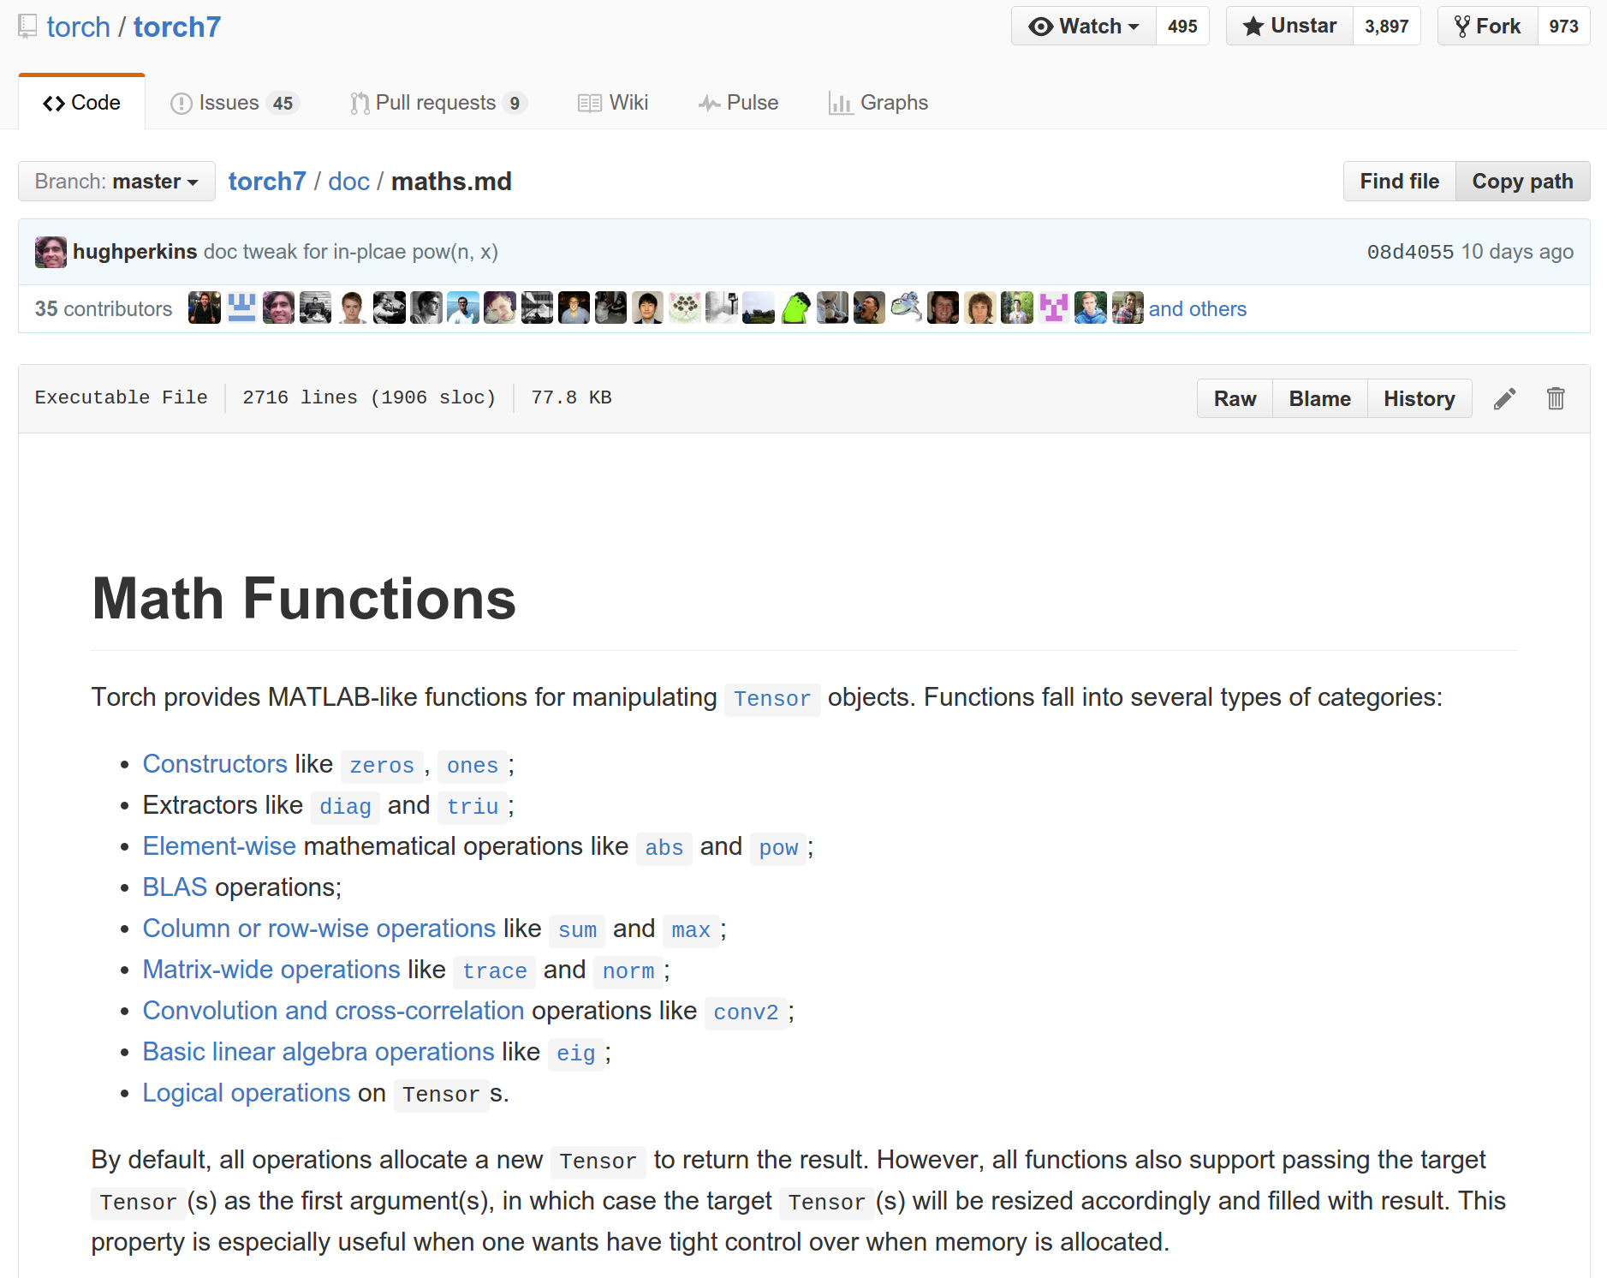
Torch: Tensors
Documentation on GitHub:
https://github.com/torch/torch7/blob/master/doc/tensor.md
https://github.com/torch/torch7/blob/master/doc/maths.md

Slide 40
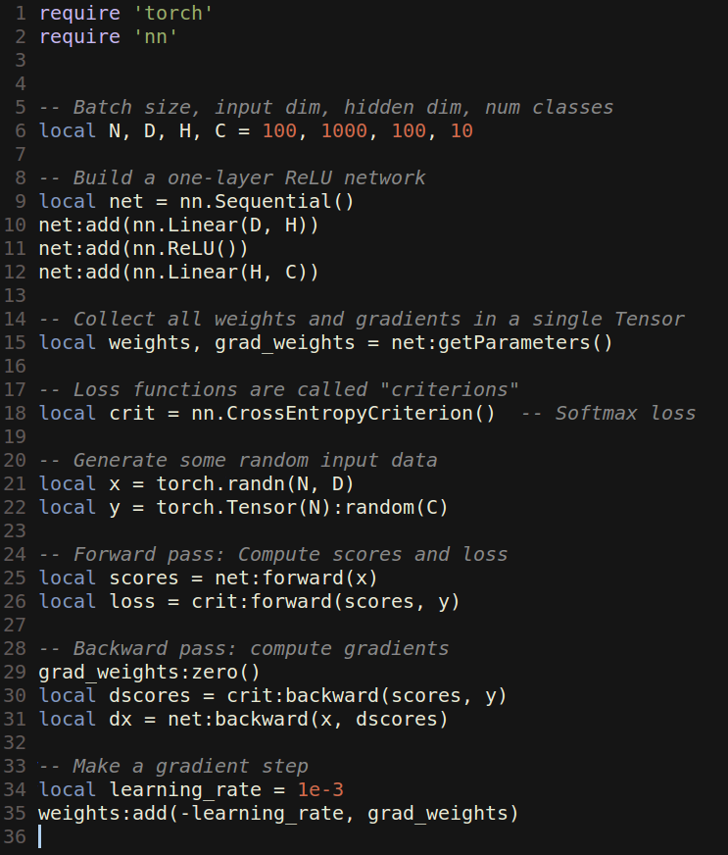
Torch: nn
nn module lets you easily build and train neural nets

Slide 41
Torch: nn
nn module lets you easily build and train neural nets
Build a two-layer ReLU net

Slide 42
Torch: nn
nn module lets you easily build and train neural nets
Get weights and gradient for entire network

Slide 43
Torch: nn
nn module lets you easily build and train neural nets
Use a softmax loss function

Slide 44
Torch: nn
nn module lets you easily build and train neural nets
Generate random data

Slide 45
Torch: nn
nn module lets you easily build and train neural nets
Forward pass: compute scores and loss(using criterion class)

Slide 46
Torch: nn
nn module lets you easily build and train neural nets
Backward pass: Compute gradients. Remember to set weight gradients to zero! (This will update the grad_weights params) Compute backward on the loss func and then a backward on the network

Slide 47
Torch: nn
nn module lets you easily build and train neural nets
Update: Make a gradient descent step

Slide 48
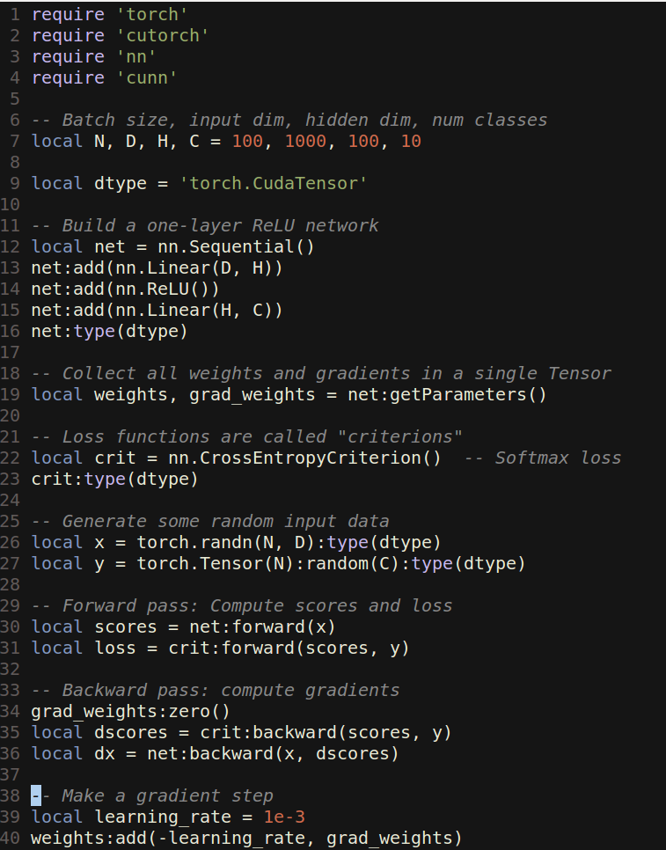
Torch: cunn
Running on GPU is easy:

Slide 49
Torch: cunn
Running on GPU is easy:
Import a few new packages

Slide 50
Torch: cunn
Running on GPU is easy:
Import a few new packages
Cast network and criterion

Slide 51
Torch: cunn
Running on GPU is easy:
Import a few new packages
Cast network and criterion
Cast data and labels
Now the whole network will run on a GPU

Slide 52
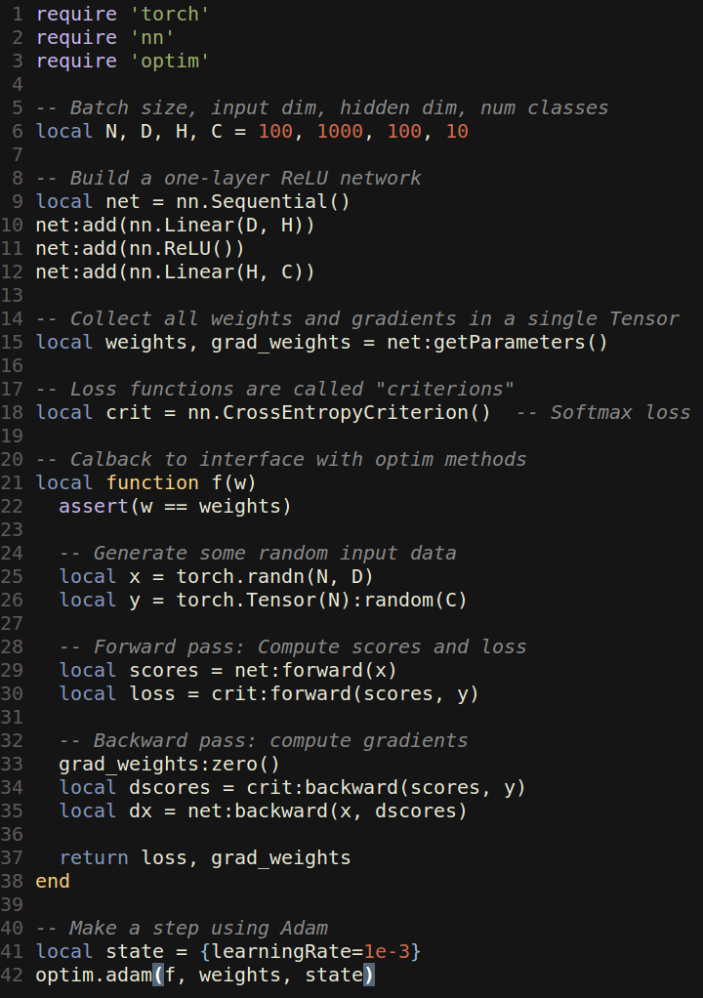
Torch: optim
optim package implements different update rules: momentum, Adam, etc

Slide 53
Torch: optim
optim package implements different update rules: momentum, Adam, etc
Import optim package

Slide 54
Torch: optim
optim package implements different update rules: momentum, Adam, etc
Import optim package
Write a callback function that returns loss and gradients

Slide 55
Torch: optim
optim package implements different update rules: momentum, Adam, etc
Import optim package
Write a callback function that returns loss and gradients
state variable holds hyperparameters, cached values, etc; pass it to adam

Slide 56
Torch: Modules
Caffe has Nets and Layers; Torch just has Modules

Slide 57
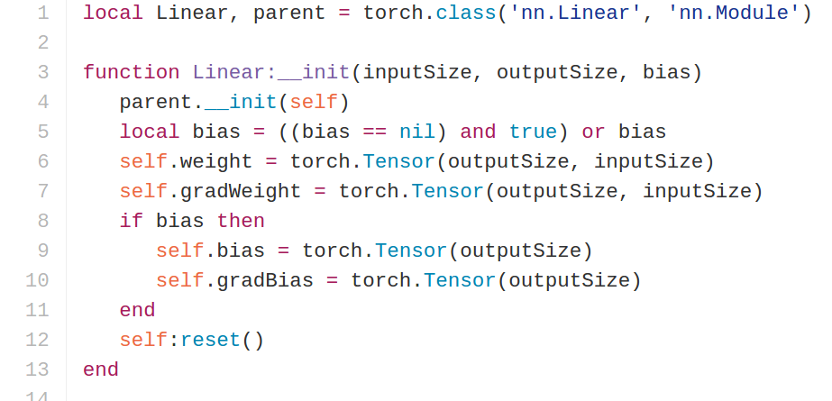
Torch: Modules
Caffe has Nets and Layers; Torch just has Modules
Modules are classes written in Lua; easy to read and write
Forward / backward written in Lua using Tensor methods
Same code runs on CPU / GPU
Linear class implements a FC layer in torch
https://github.com/torch/nn/blob/master/Linear.lua

Slide 58
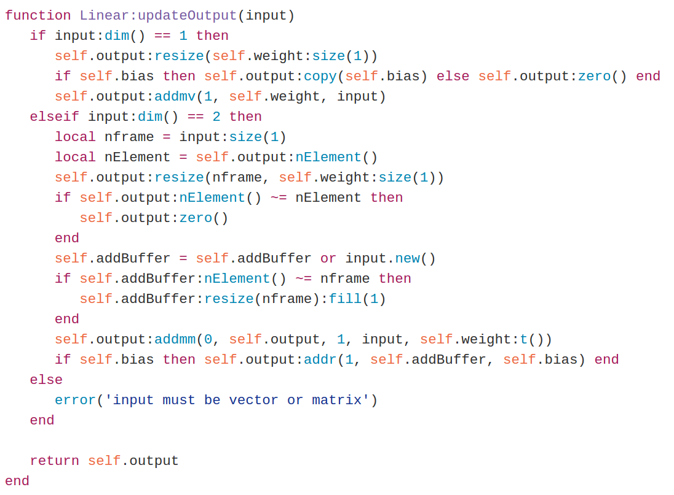
Torch: Modules
Caffe has Nets and Layers; Torch just has Modules
Modules are classes written in Lua; easy to read and write
updateOutput: Forward pass; compute output
https://github.com/torch/nn/blob/master/Linear.lua

Slide 59
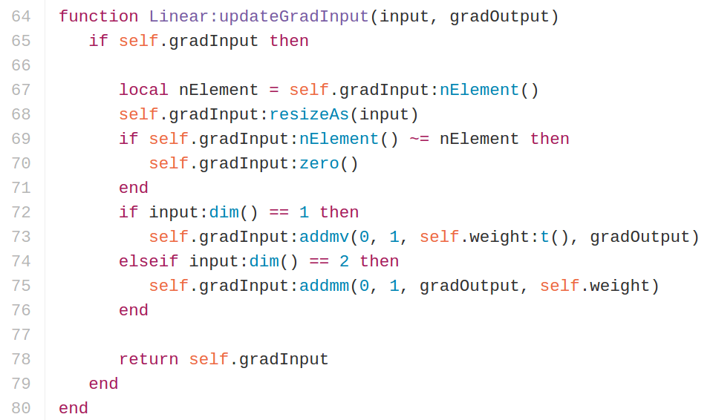
Torch: Modules
Caffe has Nets and Layers; Torch just has Modules
Modules are classes written in Lua; easy to read and write
updateGradInput: Backward; compute gradient of input
https://github.com/torch/nn/blob/master/Linear.lua

Slide 60
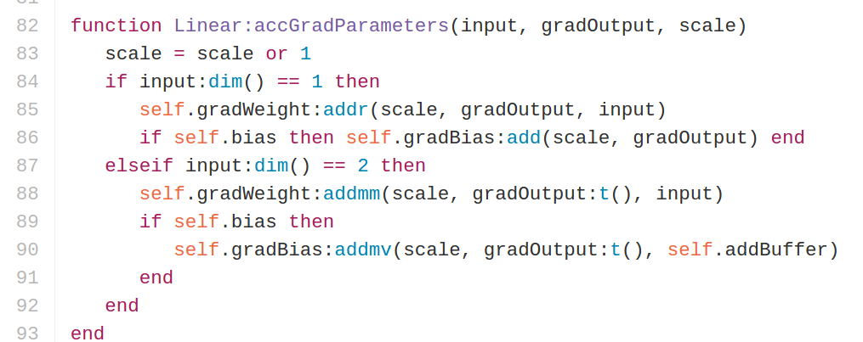
Torch: Modules
Caffe has Nets and Layers; Torch just has Modules
Modules are classes written in Lua; easy to read and write
accGradParameters: Backward; compute gradient of weights
https://github.com/torch/nn/blob/master/Linear.lua

Slide 61
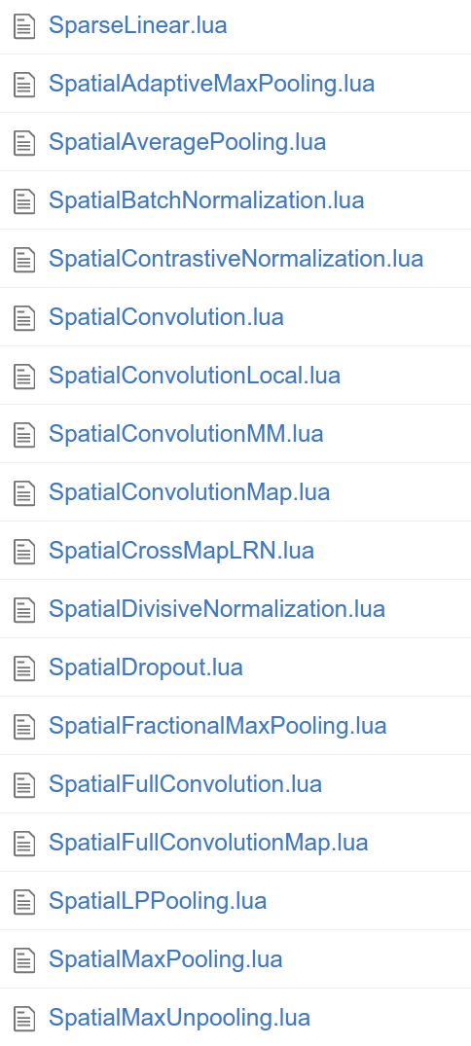
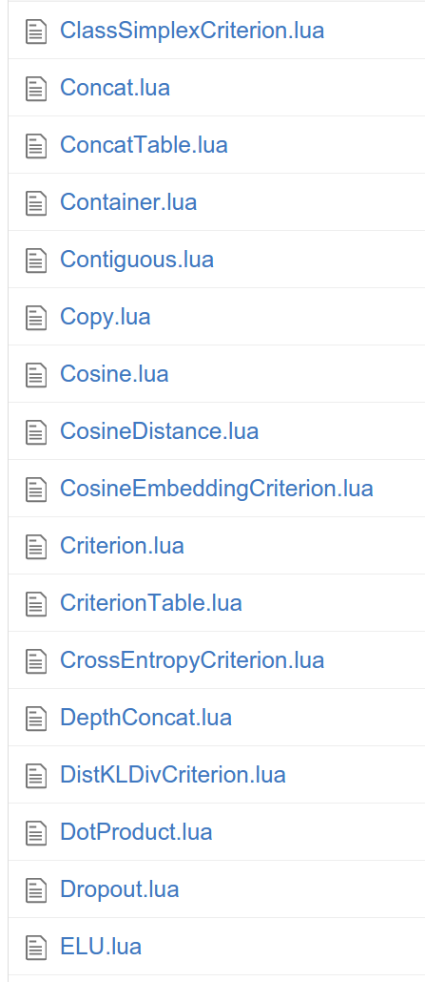
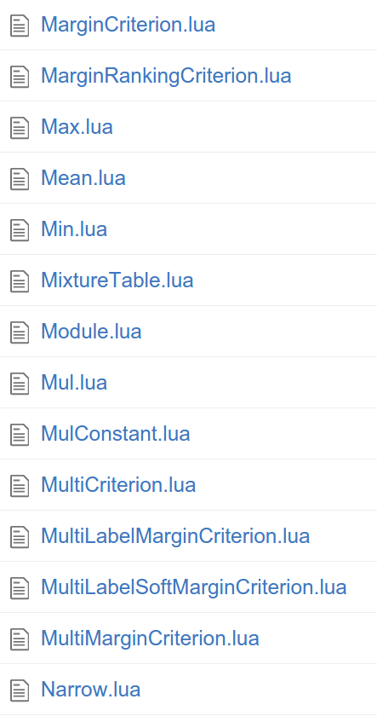
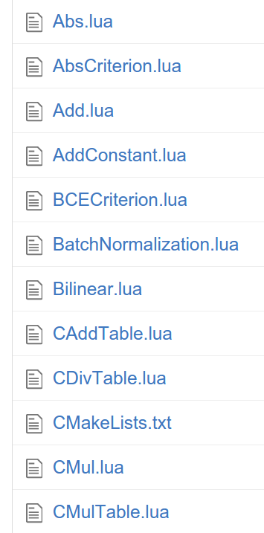
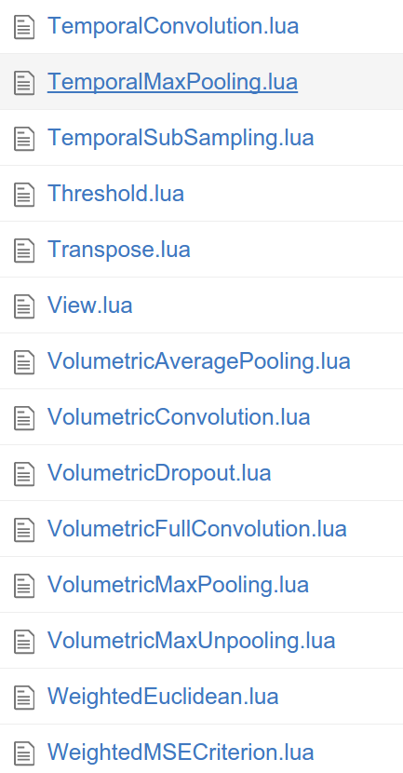
Torch: Modules
Tons of built-in modules and loss functions
(find them on github, they are updated very frequently)
https://github.com/torch/nn

Slide 62
Torch: Modules
Added 2/19/2016
Added 2/16/2016
Tons of built-in modules and loss functions
New ones all the time:
https://github.com/torch/nn

Slide 63
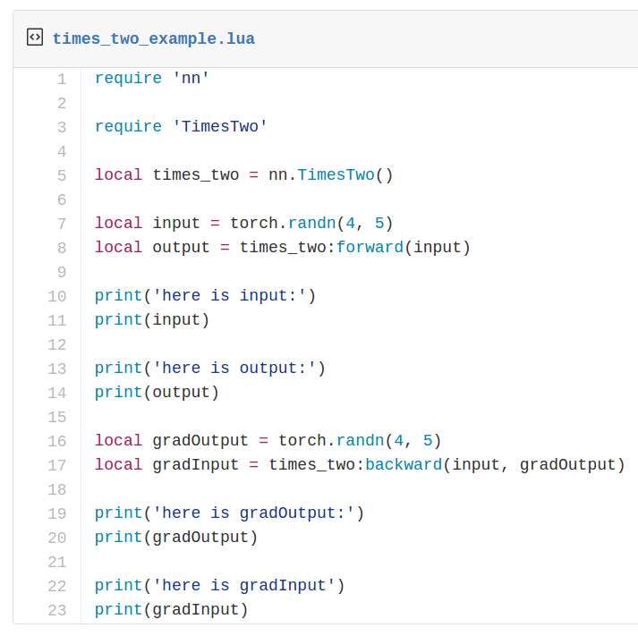
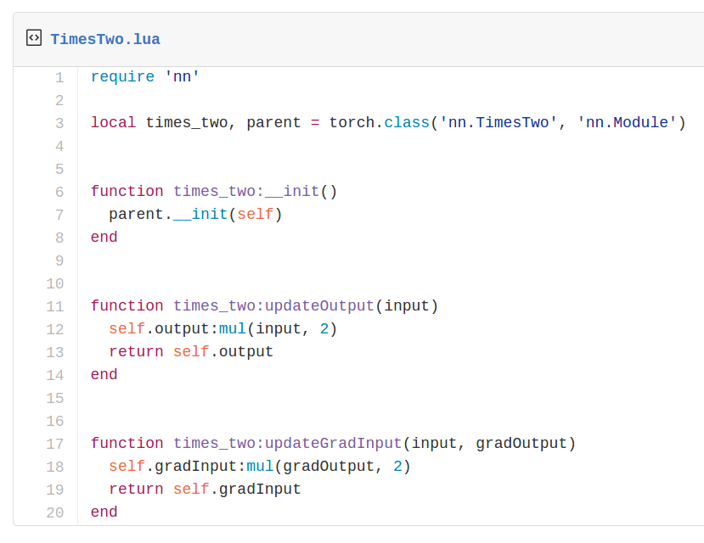
Torch: Modules
Writing your own modules is easy!

Slide 64
Torch: Modules
Container modules allow you to combine multiple modules

Slide 65
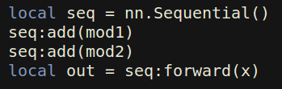
Torch: Modules
Container modules allow you to combine multiple modules
x
mod1
mod2
out

Slide 66
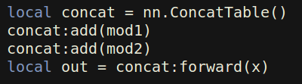
Torch: Modules
Container modules allow you to combine multiple modules
x
x
mod1
mod1
mod2
mod2
out
out[1]
out[2]

Slide 67
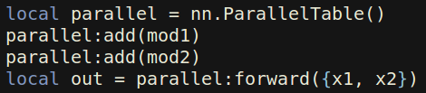
Torch: Modules
Container modules allow you to combine multiple modules
x
x
x1
x2
mod1
mod1
mod2
mod1
mod2
mod2
out[1]
out[2]
out[1]
out[2]
out

Slide 68
Torch: nngraph
Use nngraph to build modules that combine their inputs in complex ways
Inputs: x, y, z
Outputs: c
a = x + y
b = a ☉ z
c = a + b

Slide 69
Torch: nngraph
x
y
z
+
Use nngraph to build modules that combine their inputs in complex ways
a
☉
Inputs: x, y, z
Outputs: c
a = x + y
b = a ☉ z
c = a + b
b
+
c

Slide 70
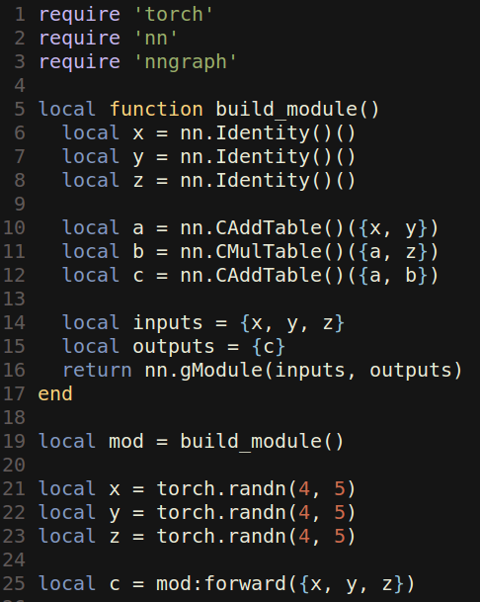
Torch: nngraph
x
y
z
+
Use nngraph to build modules that combine their inputs in complex ways
a
☉
Inputs: x, y, z
Outputs: c
a = x + y
b = a ☉ z
c = a + b
b
+
c

Slide 71
Torch: Pretrained Models
loadcaffe: Load pretrained Caffe models: AlexNet, VGG, some others https://github.com/szagoruyko/loadcaffe
GoogLeNet v1: https://github.com/soumith/inception.torch
GoogLeNet v3: https://github.com/Moodstocks/inception-v3.torch
ResNet: https://github.com/facebook/fb.resnet.torch

Slide 72
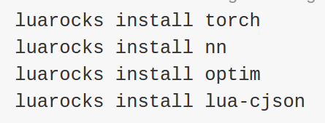
Torch: Package Management
After installing torch, use luarocks to install or update Lua packages
(Similar to pip install from Python)

Slide 73
Torch: Other useful packages
torch.cudnn: Bindings for NVIDIA cuDNN kernels https://github.com/soumith/cudnn.torch
torch-hdf5: Read and write HDF5 files from Torch https://github.com/deepmind/torch-hdf5
lua-cjson: Read and write JSON files from Lua https://luarocks.org/modules/luarocks/lua-cjson
cltorch, clnn: OpenCL backend for Torch, and port of nn https://github.com/hughperkins/cltorch, https://github.com/hughperkins/clnn
torch-autograd: Automatic differentiation; sort of like more powerful nngraph, similar to Theano or TensorFlow https://github.com/twitter/torch-autograd
fbcunn: Facebook: FFT conv, multi-GPU (DataParallel, ModelParallel) https://github.com/facebook/fbcunn

Slide 74
Torch: Typical Workflow
Step 1: Preprocess data; usually use a Python script to dump data to HDF5(for large data) and JSON(for small data)
Step 2: Train a model in Lua / Torch; read from HDF5 datafile, save trained model to disk
Step 3: Use trained model for something, often with an evaluation script

Slide 75
Torch: Typical Workflow
Example: https://github.com/jcjohnson/torch-rnn
Step 1: Preprocess data; usually use a Python script to dump data to HDF5 (https://github.com/jcjohnson/torch-rnn/blob/master/scripts/preprocess.py)
Step 2: Train a model in Lua / Torch; read from HDF5 datafile, save trained model to disk (https://github.com/jcjohnson/torch-rnn/blob/master/train.lua )
Step 3: Use trained model for something, often with an evaluation script (https://github.com/jcjohnson/torch-rnn/blob/master/sample.lua)
(converts text file into HD5 file)
(Loads the HD5 file and trains these recurrent networks)
Loads the checkpoints and generates the text files

Slide 76
Torch: Pros / Cons
(-) Lua
(-) Less plug-and-play than Caffe
You usually write your own training code
(+) Lots of modular pieces that are easy to combine
(+) Easy to write your own layer types and run on GPU
(+) Most of the library code is in Lua, easy to read
(+) Lots of pretrained models!
(-) Not great for RNNs

Slide 77
Theano
http://deeplearning.net/software/theano/

Slide 78
Theano Overview
From Yoshua Bengio’s group at University of Montreal
Embracing computation graphs, symbolic computation
High-level wrappers: Keras, Lasagne

Slide 79
Theano: Computational Graphs
x
y
z
+
a
☉
b
+
c

Slide 80
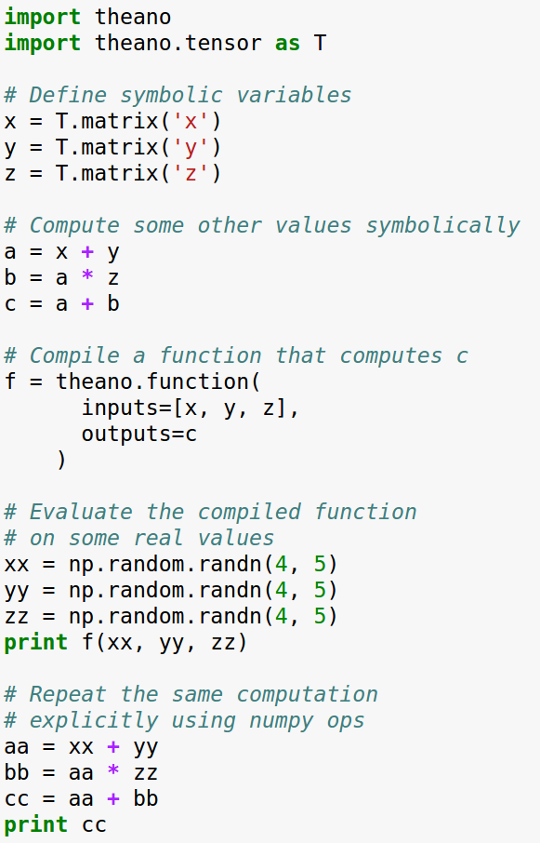
Theano: Computational Graphs
x
y
z
+
a
☉
b
+
c

Slide 81
Theano: Computational Graphs
x
y
z
Define symbolic variables;
these are inputs to the graph(symbolic variables not numpy arrays)
+
a
☉
b
+
c

Slide 82
Theano: Computational Graphs
x
y
z
Compute intermediates and outputs symbolically
+
a
☉
b
+
c

Slide 83
Theano: Computational Graphs
x
y
z
Compile a function that produces c from x, y, z
(generates code)
+
a
☉
b
+
c

Slide 84
Theano: Computational Graphs
x
y
z
Run the function, passing some numpy arrays
(may run on GPU)
+
a
☉
b
+
c

Slide 85
Theano: Computational Graphs
x
y
z
Repeat the same computation using numpy operations (runs on CPU)
+
a
☉
b
+
c

Slide 86
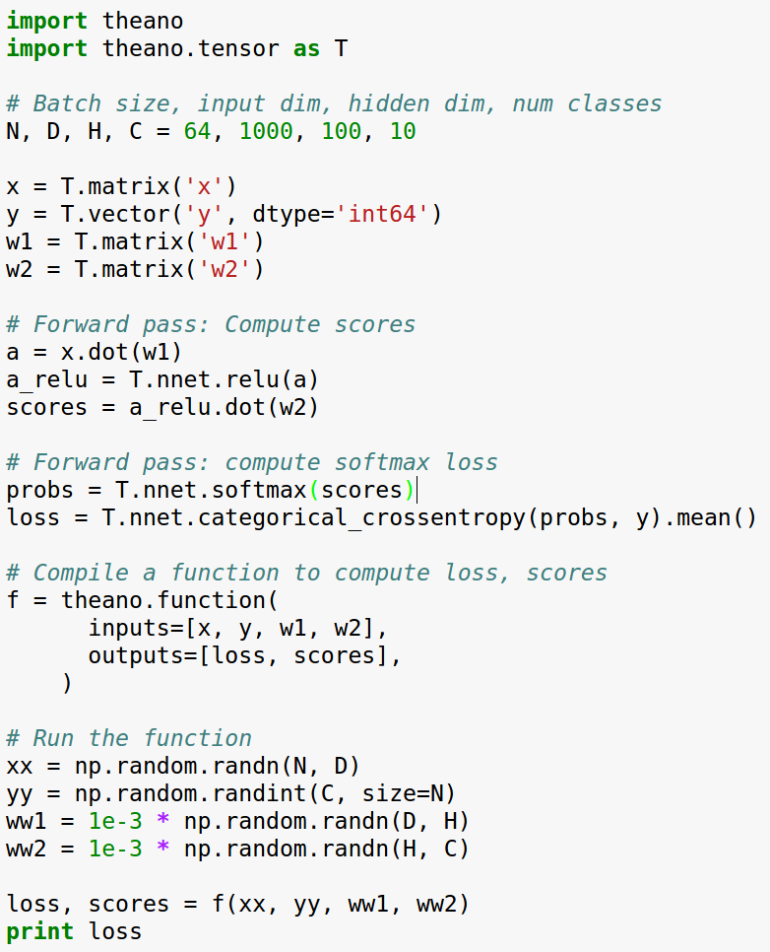
Theano: Simple Neural Net

Slide 87
Theano: Simple Neural Net
Define symbolic variables:
x = data
y = labels
w1 = first-layer weights
w2 = second-layer weights

Slide 88
Theano: Simple Neural Net
Forward: Compute scores (symbolically)

Slide 89
Theano: Simple Neural Net
Forward: Compute probs, loss (symbolically)

Slide 90
Theano: Simple Neural Net
Compile a function that computes loss, scores

Slide 91
Theano: Simple Neural Net
Stuff actual numpy arrays into the function

Slide 92
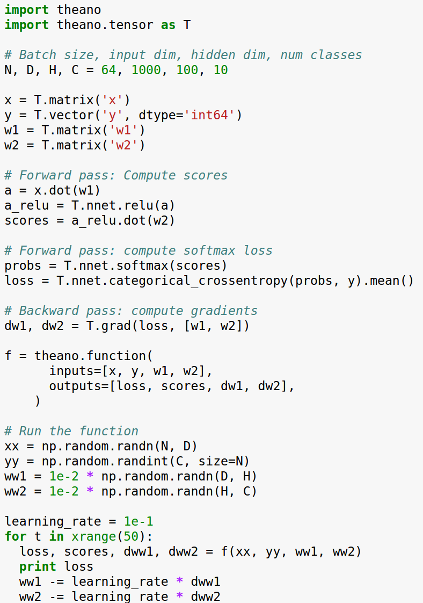
Theano: Computing Gradients

Slide 93
Theano: Computing Gradients
Same as before: define variables, compute scores and loss symbolically

Slide 94
Theano: Computing Gradients
Theano computes gradients for us symbolically!

Slide 95
Theano: Computing Gradients
Now the function returns loss, scores, and gradients

Slide 96
Theano: Computing Gradients
Use the function to perform gradient descent!

Slide 97
Theano: Computing Gradients
Problem: Shipping weights and gradients to CPU on every iteration to update...
(whenever f returns gradients(computed by GPU) gradients are copied back to the CPU.. And the updates are done on the CPU)

Slide 98
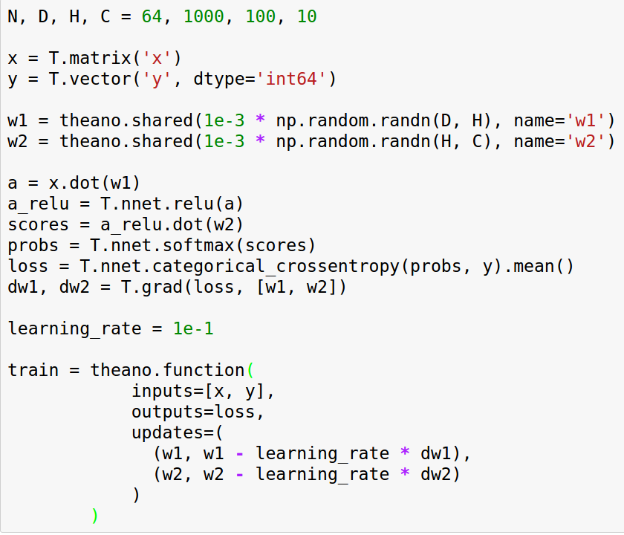
Theano: Shared Variables
Same as before: Define dimensions, define symbolic variables for x, y

Slide 99
Theano: Shared Variables
Define weights as shared variables that persist in the graph between calls; initialize with numpy arrays

Slide 100
Theano: Shared Variables
Same as before: Compute scores, loss, gradients symbolically

Slide 101
Theano: Shared Variables
Compiled function inputs are x and y; weights live in the graph

Slide 102
Theano: Shared Variables
Function includes an update that updates weights on every call

Slide 103
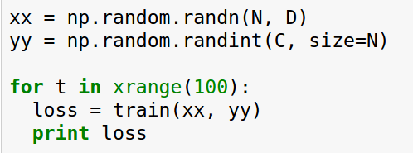
Theano: Shared Variables
To train the net, just call function repeatedly!

Slide 104
Theano: Other Topics
Conditionals: The ifelse and switch functions allow conditional control flow in the graph
Loops: The scan function allows for (some types) of loops in the computational graph; good for RNNs
Derivatives: Efficient Jacobian / vector products with R and L operators, symbolic hessians (gradient of gradient)
Sparse matrices, optimizations, etc

Slide 105
Theano: Multi-GPU
Experimental model parallelism: (Divides the computational graph work on multiple GPUs, but it is expreimental)
http://deeplearning.net/software/theano/tutorial/using_multi_gpu.html
Data parallelism using platoon: (Divides the data to different GPUs)
https://github.com/mila-udem/platoon

Slide 106
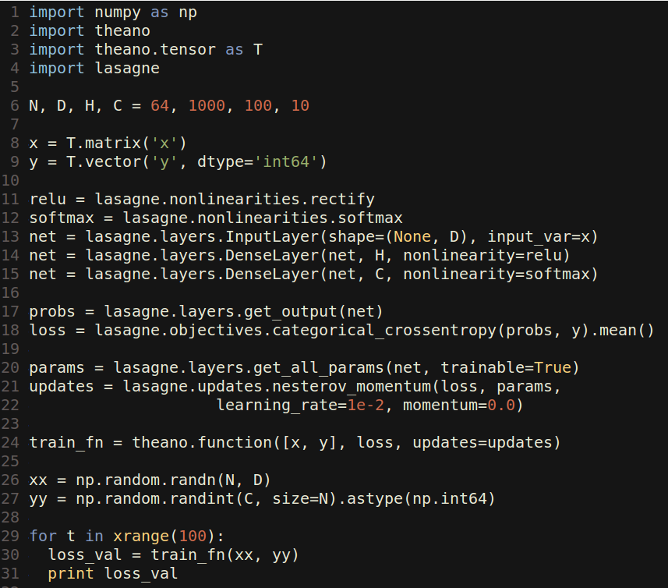
Lasagne: High Level Wrapper
Lasagne gives layer abstractions, sets up weights for you, writes update rules for you

Slide 107
Lasagne: High Level Wrapper
Set up symbolic Theano variables for data, labels

Slide 108
Lasagne: High Level Wrapper
Forward: Use Lasagne layers to set up layers; don’t set up weights explicitly

Slide 109
Lasagne: High Level Wrapper
Forward: Use Lasagne layers to compute loss

Slide 110
Lasagne: High Level Wrapper
Lasagne gets parameters, and writes the update rule for you

Slide 111
Lasagne: High Level Wrapper
Same as Theano: compile a function with updates, train model by calling function with arrays

Slide 112
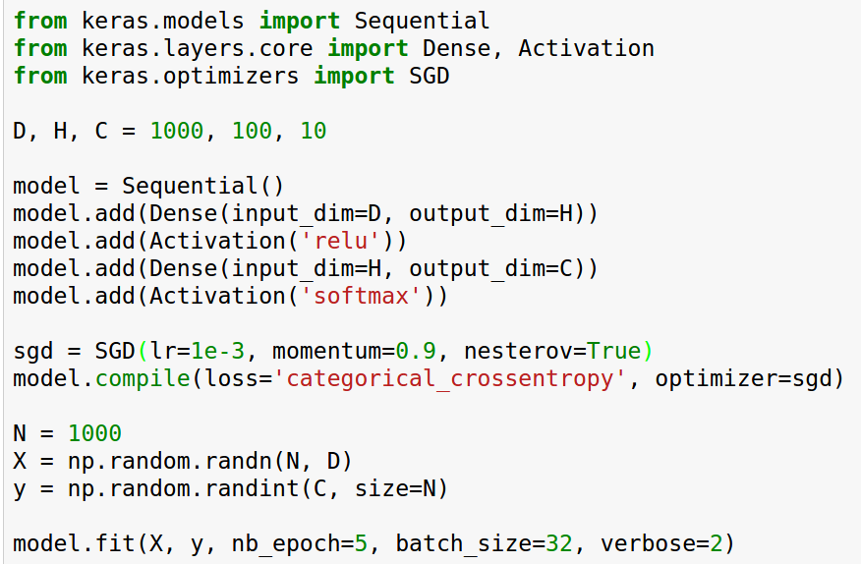
Keras: High level wrapper
keras is a layer on top of Theano; makes common things easy to do
(Also supports TensorFlow backend)

Slide 113
Keras: High level wrapper
keras is a layer on top of Theano; makes common things easy to do
Set up a two-layer ReLU net with softmax (with sequential object-just like Torch)

Slide 114
Keras: High level wrapper
keras is a layer on top of Theano; makes common things easy to do
We will optimize the model using SGD with Nesterov momentum

Slide 115
Keras: High level wrapper
keras is a layer on top of Theano; makes common things easy to do
Generate some random data and train the model

Slide 116
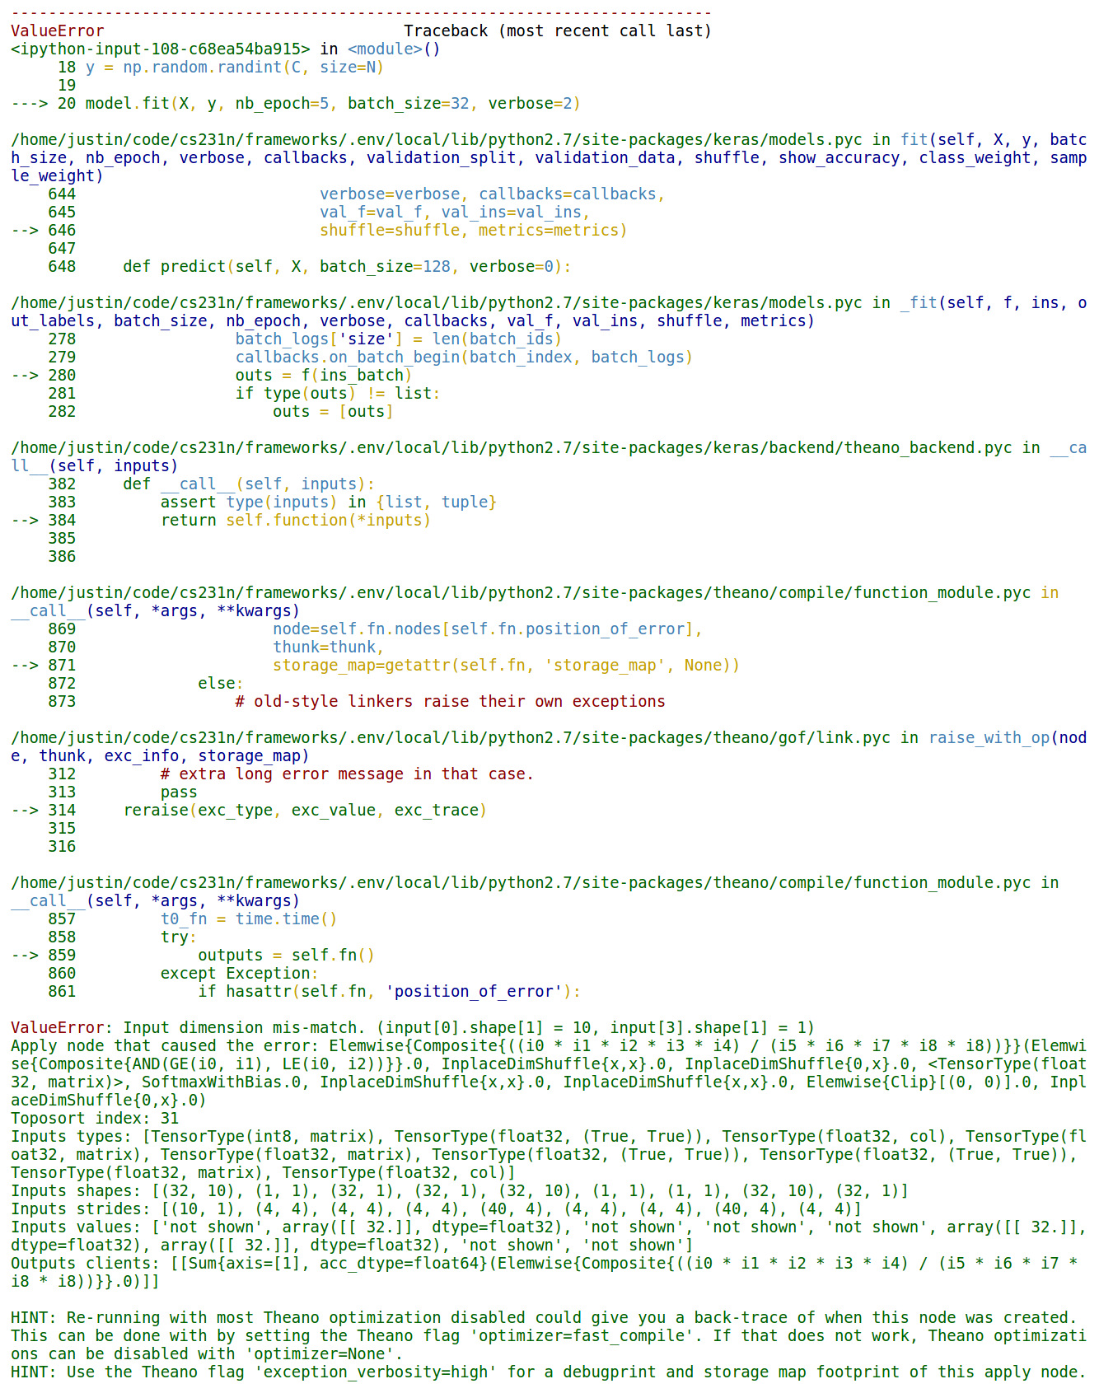
Keras: High level wrapper
Problem: It crashes, stack trace and error message not useful :(
Error messages are not very helpful here. Since, it uses Theano on the backend. Theano gives very insensible errors
Notes:
Input dimension mis-match. (input[0].shape[1] = 10, input[3].shape[1] = 1) Apply node that caused the error: Elemwise{Composite{((i0 * i1 * i2 * i3 * i4) / (i5 * i6 * i7 * i8 * i8))}}(Elemwise{Composite{AND(GE(i0, i1), LE(i0, i2))}}.0, InplaceDimShuffle{x,x}.0, InplaceDimShuffle{0,x}.0, <TensorType(float32, matrix)>, SoftmaxWithBias.0, InplaceDimShuffle{x,x}.0, InplaceDimShuffle{x,x}.0, Elemwise{Clip}[(0, 0)].0, InplaceDimShuffle{0,x}.0) Toposort index: 31 Inputs types: [TensorType(int8, matrix), TensorType(float32, (True, True)), TensorType(float32, col), TensorType(float32, matrix), TensorType(float32, matrix), TensorType(float32, (True, True)), TensorType(float32, (True, True)), TensorType(float32, matrix), TensorType(float32, col)] Inputs shapes: [(32, 10), (1, 1), (32, 1), (32, 1), (32, 10), (1, 1), (1, 1), (32, 10), (32, 1)] Inputs strides: [(10, 1), (4, 4), (4, 4), (4, 4), (40, 4), (4, 4), (4, 4), (40, 4), (4, 4)] Inputs values: ['not shown', array([[ 32.]], dtype=float32), 'not shown', 'not shown', 'not shown', array([[ 32.]], dtype=float32), array([[ 32.]], dtype=float32), 'not shown', 'not shown'] Outputs clients: [[Sum{axis=[1], acc_dtype=float64}(Elemwise{Composite{((i0 * i1 * i2 * i3 * i4) / (i5 * i6 * i7 * i8 * i8))}}.0)]] HINT: Re-running with most Theano optimization disabled could give you a back-trace of when this node was created. This can be done with by setting the Theano flag 'optimizer=fast_compile'. If that does not work, Theano optimizations can be disabled with 'optimizer=None'. HINT: Use the Theano flag 'exception_verbosity=high' for a debugprint and storage map footprint of this apply node.

Slide 117
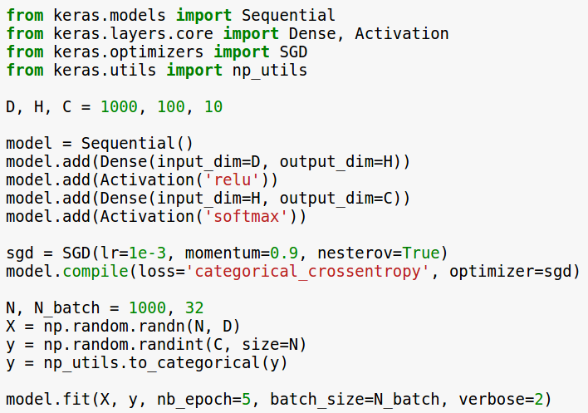
Keras: High level wrapper
Solution: y should be one-hot
(too much API for me … )
Notes:
Input dimension mis-match. (input[0].shape[1] = 10, input[3].shape[1] = 1) Apply node that caused the error: Elemwise{Composite{((i0 * i1 * i2 * i3 * i4) / (i5 * i6 * i7 * i8 * i8))}}(Elemwise{Composite{AND(GE(i0, i1), LE(i0, i2))}}.0, InplaceDimShuffle{x,x}.0, InplaceDimShuffle{0,x}.0, <TensorType(float32, matrix)>, SoftmaxWithBias.0, InplaceDimShuffle{x,x}.0, InplaceDimShuffle{x,x}.0, Elemwise{Clip}[(0, 0)].0, InplaceDimShuffle{0,x}.0) Toposort index: 31 Inputs types: [TensorType(int8, matrix), TensorType(float32, (True, True)), TensorType(float32, col), TensorType(float32, matrix), TensorType(float32, matrix), TensorType(float32, (True, True)), TensorType(float32, (True, True)), TensorType(float32, matrix), TensorType(float32, col)] Inputs shapes: [(32, 10), (1, 1), (32, 1), (32, 1), (32, 10), (1, 1), (1, 1), (32, 10), (32, 1)] Inputs strides: [(10, 1), (4, 4), (4, 4), (4, 4), (40, 4), (4, 4), (4, 4), (40, 4), (4, 4)] Inputs values: ['not shown', array([[ 32.]], dtype=float32), 'not shown', 'not shown', 'not shown', array([[ 32.]], dtype=float32), array([[ 32.]], dtype=float32), 'not shown', 'not shown'] Outputs clients: [[Sum{axis=[1], acc_dtype=float64}(Elemwise{Composite{((i0 * i1 * i2 * i3 * i4) / (i5 * i6 * i7 * i8 * i8))}}.0)]] HINT: Re-running with most Theano optimization disabled could give you a back-trace of when this node was created. This can be done with by setting the Theano flag 'optimizer=fast_compile'. If that does not work, Theano optimizations can be disabled with 'optimizer=None'. HINT: Use the Theano flag 'exception_verbosity=high' for a debugprint and storage map footprint of this apply node.

Slide 118
Theano: Pretrained Models
Lasagne Model Zoo has pretrained common architectures:
https://github.com/Lasagne/Recipes/tree/master/modelzoo
AlexNet with weights: https://github.com/uoguelph-mlrg/theano_alexnet
sklearn-theano: Run OverFeat and GoogLeNet forward, but no fine-tuning? http://sklearn-theano.github.io
caffe-theano-conversion: CS 231n project from last year: load models and weights from caffe! Not sure if full-featured https://github.com/kitofans/caffe-theano-conversion

Slide 119
Theano: Pretrained Models
Best choice
Lasagne Model Zoo has pretrained common architectures:
https://github.com/Lasagne/Recipes/tree/master/modelzoo
AlexNet with weights: https://github.com/uoguelph-mlrg/theano_alexnet
sklearn-theano: Run OverFeat and GoogLeNet forward, but no fine-tuning? http://sklearn-theano.github.io
caffe-theano-conversion: CS 231n project from last year: load models and weights from caffe! Not sure if full-featured https://github.com/kitofans/caffe-theano-conversion

Slide 120
Theano: Pros / Cons
(+) Python + numpy
(+) Computational graph is nice abstraction
(+) RNNs fit nicely in computational graph
(-) Raw Theano is somewhat low-level (lasagane fixes this)
(+) High level wrappers (Keras, Lasagne) ease the pain
(-) Error messages can be unhelpful
(-) Large models can have long compile times
(-) Much “fatter” than Torch; more magic (makes things difficult while debugging.. You don’t know much what’s going on behind the scenes)
(-) Patchy support for pretrained models (lasgane is pretty good with this)

Slide 121
TensorFlow
https://www.tensorflow.org

Slide 122
TensorFlow
From Google
Very similar to Theano - all about computation graphs
Easy visualizations (TensorBoard)
Multi-GPU and multi-node training

Slide 123
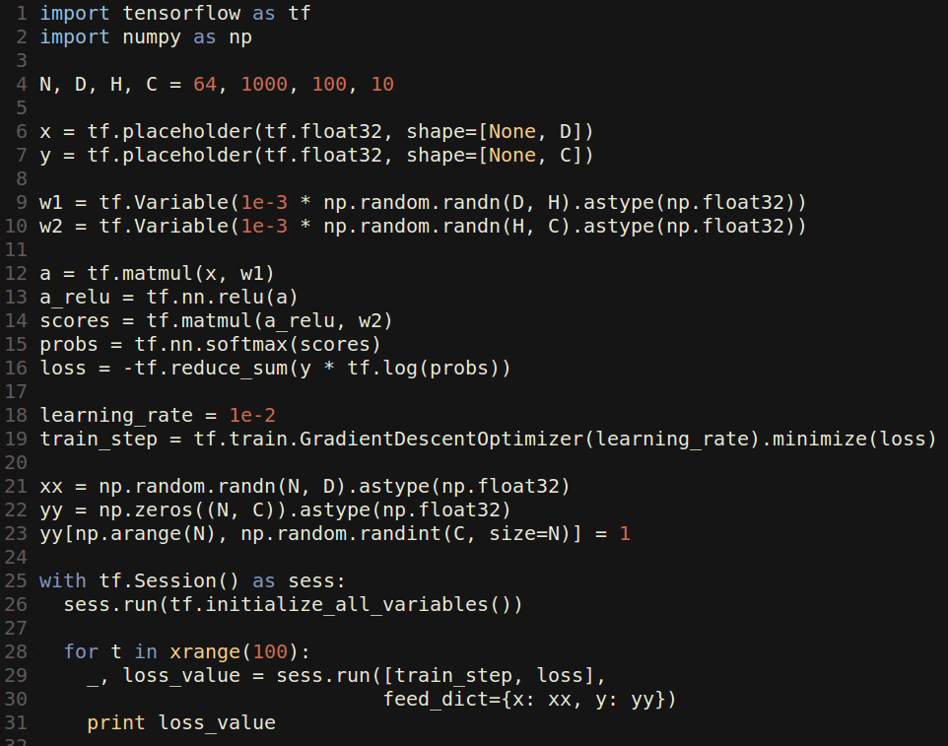
TensorFlow: Two-Layer Net

Slide 124
TensorFlow: Two-Layer Net
Create placeholders (similar to symbolic variables in Theano) for data and labels: These will be fed to the graph

Slide 125
TensorFlow: Two-Layer Net
Create Variables to hold weights; similar to Theano shared variables
Initialize variables with numpy arrays

Slide 126
TensorFlow: Two-Layer Net
Forward: Compute scores, probs, loss (symbolically)

Slide 127
TensorFlow: Two-Layer Net
Running train_step will use SGD to minimize loss

Slide 128
TensorFlow: Two-Layer Net
Create an artificial dataset; y is one-hot like Keras

Slide 129
TensorFlow: Two-Layer Net
Actually train the model
Goes inside a session object always. Also, call the run function on session object for computing loss. Put it inside the loop.. Gradient decent will run on it and loss will go down

Slide 130
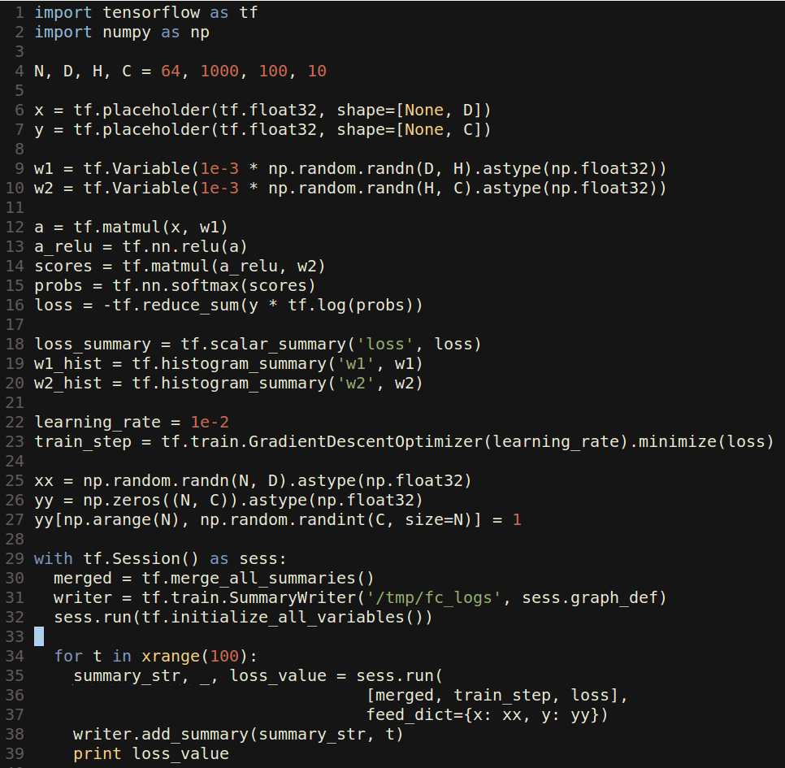
TensorFlow: Tensorboard
Tensorboard makes it easy to visualize what’s happening inside your models

Slide 131
TensorFlow: Tensorboard
Tensorboard makes it easy to visualize what’s happening inside your models
Same as before, but now we create summaries for loss and weights

Slide 132
TensorFlow: Tensorboard
Tensorboard makes it easy to visualize what’s happening inside your models
Create a special “merged” variable and a SummaryWriter object- dumps out the summary to disk

Slide 133
TensorFlow: Tensorboard
Tensorboard makes it easy to visualize what’s happening inside your models
In the training loop, also run merged and pass its value to the writer

Slide 134
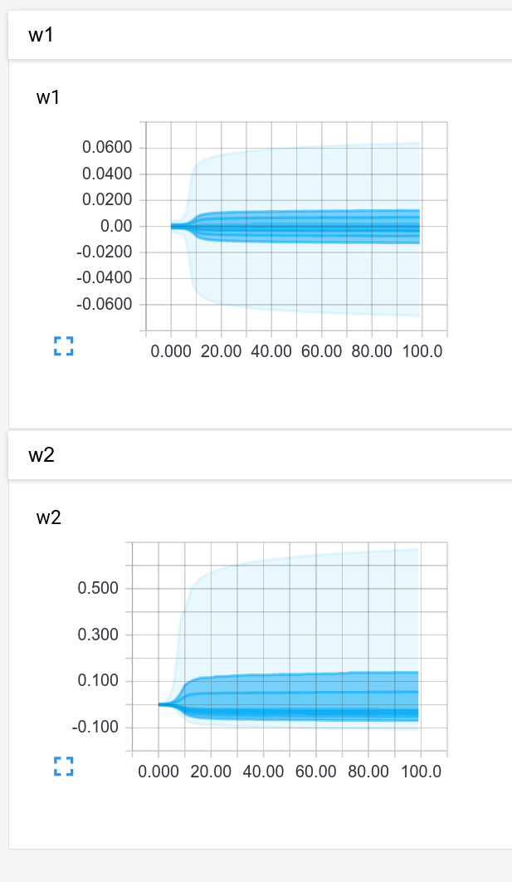
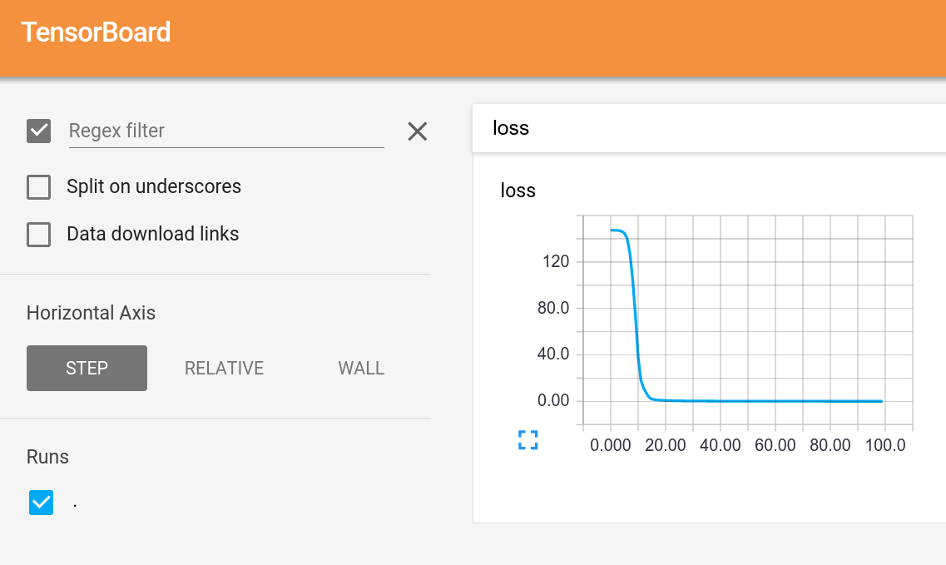
TensorFlow: Tensorboard
Start Tensorboard server, and we get graphs!

Slide 135

TensorFlow: TensorBoard

Slide 136
TensorFlow: TensorBoard
Add names to placeholders and variables

Slide 137
TensorFlow: TensorBoard
Add names to placeholders and variables
Break up the forward pass with name scoping

Slide 138

TensorFlow: TensorBoard
Tensorboard shows the graph!

Slide 139

TensorFlow: TensorBoard
Tensorboard shows the graph!
Name scopes expand to show individual operations

Slide 140

TensorFlow: Multi-GPU
Data parallelism: synchronous or asynchronous

Slide 141

TensorFlow: Multi-GPU
Data parallelism: synchronous or asynchronous
Model parallelism: Split model across GPUs (can be very useful for RNNs)

Slide 142

TensorFlow: Distributed
Single machine:
Like other frameworks
Many machines:
Not open source (yet) =(

Slide 143
TensorFlow: Pretrained Models
You can get a pretrained version of Inception here:
https://github.com/tensorflow/tensorflow/blob/master/tensorflow/examples/android/README.md
(In an Android example?? Very well-hidden)
The only one I could find =(

Slide 144
TensorFlow: Pros / Cons
(+) Python + numpy
(+) Computational graph abstraction, like Theano; great for RNNs
(+) Much faster compile times than Theano
(+) Slightly more convenient than raw Theano?
(+) TensorBoard for visualization
(+) Data AND model parallelism; best of all frameworks
(+/-) Distributed models, but not open-source yet
(-) Slower than other frameworks right now
(-) Much “fatter” than Torch; more magic
(-) Not many pretrained models

Slide 145
Overview
 | Caffe | Torch | Theano | TensorFlow
Language | C++, Python | Lua | Python | Python
Pretrained | Yes ++ | Yes ++ | Yes (Lasagne) | Inception
Multi-GPU: Data parallel | Yes | Yes cunn.DataParallelTable | Yes platoon | Yes
Multi-GPU: Model parallel | No | Yes fbcunn.ModelParallel | Experimental | Yes (best)
Readable source code | Yes (C++) | Yes (Lua) | No | No
Good at RNN | No | Mediocre | Yes | Yes (best)

Slide 146
Use Cases
Extract AlexNet or VGG features?

Slide 147
Use Cases
Extract AlexNet or VGG features? Use Caffe

Slide 148
Use Cases
Fine-tune AlexNet for new classes?

Slide 149
Use Cases
Fine-tune AlexNet for new classes? Use Caffe

Slide 150
Use Cases
Image Captioning with finetuning?

Slide 151
Use Cases
Image Captioning with finetuning?
-> Need pretrained models (Caffe, Torch, Lasagne)
-> Need RNNs (Torch or Lasagne)
-> Use Torch or Lasagna

Slide 152
Use Cases
Segmentation? (Classify every pixel)

Slide 153
Use Cases
Segmentation? (Classify every pixel)
-> Need pretrained model (Caffe, Torch, Lasagna)
-> Need funny loss function
-> If loss function exists in Caffe: Use Caffe
-> If you want to write your own loss: Use Torch

Slide 154
Use Cases
Object Detection?

Slide 155
Use Cases
Object Detection?
-> Need pretrained model (Torch, Caffe, Lasagne)
-> Need lots of custom imperative code (NOT Lasagne)
-> Use Caffe + Python or Torch

Slide 156
Use Cases
Language modeling with new RNN structure?

Slide 157
Use Cases
Language modeling with new RNN structure?
-> Need easy recurrent nets (NOT Caffe, Torch)
-> No need for pretrained models
-> Use Theano or TensorFlow

Slide 158
Use Cases
Implement BatchNorm?
-> Don’t want to derive gradient? Theano or TensorFlow
-> Implement efficient backward pass? Use Torch

Slide 159
My Recommendation
Feature extraction / finetuning existing models: Use Caffe
Complex uses of pretrained models: Use Lasagne or Torch
Write your own layers: Use Torch
Crazy RNNs: Use Theano or Tensorflow
Huge model, need model parallelism: Use TensorFlow

Slide 162



Caffe: Blobs
https://github.com/BVLC/caffe/blob/master/include/caffe/blob.hpp

Slide 163
Caffe: Blobs
N-dimensional array for storing activations and weights
https://github.com/BVLC/caffe/blob/master/include/caffe/blob.hpp

Slide 164
Caffe: Blobs
N-dimensional array for storing activations and weights
Template over datatype
https://github.com/BVLC/caffe/blob/master/include/caffe/blob.hpp

Slide 165
Caffe: Blobs
N-dimensional array for storing activations and weights
Template over datatype
Two parallel tensors:
data: values
diffs: gradients
https://github.com/BVLC/caffe/blob/master/include/caffe/blob.hpp

Slide 166
Caffe: Blobs
N-dimensional array for storing activations and weights
Template over datatype
Two parallel tensors:
data: values
diffs: gradients
Stores CPU / GPU versions of each tensor
https://github.com/BVLC/caffe/blob/master/include/caffe/blob.hpp

Slide 167


Caffe: Layer
A small unit of computation
https://github.com/BVLC/caffe/blob/master/include/caffe/layer.hpp

Slide 168
Caffe: Layer
A small unit of computation
Forward: Use “bottom” data to compute “top” data
https://github.com/BVLC/caffe/blob/master/include/caffe/layer.hpp

Slide 169
Caffe: Layer
A small unit of computation
Forward: Use “bottom” data to compute “top” data
Backward: Use “top” diffs to compute “bottom” diffs
https://github.com/BVLC/caffe/blob/master/include/caffe/layer.hpp

Slide 170
Caffe: Layer
A small unit of computation
Forward: Use “bottom” data to compute “top” data
Backward: Use “top” diffs to compute “bottom” diffs
Separate CPU / GPU implementations
https://github.com/BVLC/caffe/blob/master/include/caffe/layer.hpp
Notes:
CPU implementations pure virtual; GPU implementations default to use CPU

Slide 171

Caffe: Layer
Tons of different layer types:
...
https://github.com/BVLC/caffe/tree/master/src/caffe/layers
Notes:
CPU implementations pure virtual; GPU implementations default to use CPU

Slide 172
Caffe: Layer
Tons of different layer types:
batch norm
convolution
cuDNN convolution
.cpp: CPU implementation
.cu: GPU implementation
...
https://github.com/BVLC/caffe/tree/master/src/caffe/layers
Notes:
CPU implementations pure virtual; GPU implementations default to use CPU

Slide 173



Caffe: Net
Collects layers into a DAG
Run all or part of the net forward and backward
https://github.com/BVLC/caffe/blob/master/include/caffe/net.hpp

Slide 174

Caffe: Solver
https://github.com/BVLC/caffe/blob/master/include/caffe/solver.hpp

Slide 175
Caffe: Solver
Trains a Net by running it forward / backward, updating weights
https://github.com/BVLC/caffe/blob/master/include/caffe/solver.hpp

Slide 176
Caffe: Solver
Trains a Net by running it forward / backward, updating weights
Handles snapshotting, restoring from snapshots
https://github.com/BVLC/caffe/blob/master/include/caffe/solver.hpp

Slide 177



Caffe: Solver
Trains a Net by running it forward / backward, updating weights
Handles snapshotting, restoring from snapshots
Subclasses implement different update rules
https://github.com/BVLC/caffe/blob/master/include/caffe/sgd_solvers.hpp

